Slide 1
A
B
C
Age
Sex: M F
APOE
Notes:
Figure 1. Summary statistics of the ADSP whole genome sequencing (WGS) cohort. A. AD diagnosis for 570 individuals across 111 families. B. APOE allele-type composition. C. Age distributions of individuals in each AD diagnostic category (left), sex composition in each category (middle), and APOE allele-type composition in each category (right).

Slide 2
A
B
Age
c1
Sex
c2
APOE/e2
c3
APOE/e4
0
2
4
6
-1
0
1
Notes:
Figure 2. Bayes-GLMM estimation of model parameters by MCMC sampling of GLMM. Areas shown are 95% HPD (highest posterior density). (A) Posterior distributions of the ordered categorical model’s cut points. Convergence diagnostics $\hat{R}$ of cut1, cut2, and cut3 were 1.01, 1.00, and 1.03, respectively, which implies strong convergence. (B) Posterior distributions of the model covariate’s effect sizes: age, sex, APOEε2 and APOEε4. $\hat{R}$ of Age, Sex, APOE/e2, and APOE/e4 were 1.00, 1.00, 1.01, and 1.00, respectively.

Slide 3
AD status of 570 participants
Covariates: age and sex
Autosomal SNP call by ADSP consortium (27.9 million)
Data
MAF cutoff 0.01 (10.3 million)
IBS kinship relatedness
GLM without random term, flat priors, model inference by MLE
Pre-scan
P-value cutoff 0.0001 (9726)
GLMM with random term, flat priors, model inference by MCMC
Scan
Posterior distribution of variant effects
Notes:
Figure 3. Analysis overview of two-step GWAS analysis using Bayes-GLMM. Initial data (blue) were filtered and pre-scanned with a fixed linear model (green). Results were filtered by significance and scanned using the full GLMM (orange).

Slide 4
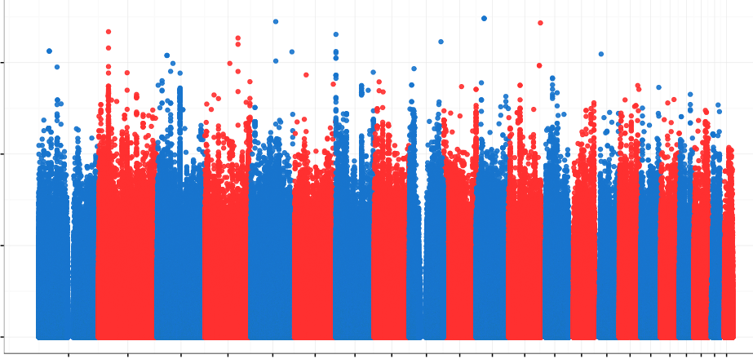
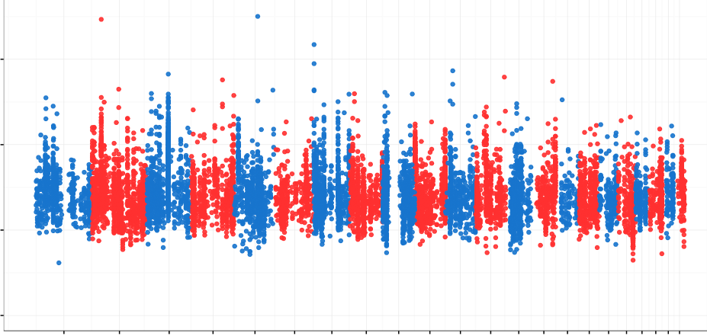
A
7.5
5.0
-log10(P)
2.5
0
B
1 3 5 7 9 11 13 15 17 19 21
2 4 6 8 10 12 14 16 18 20 22
rs10490263
rs74944275
rs149372995
7.5
rs140233081
5.0
-log10(P)
2.5
0
1 3 5 7 9 11 13 15 17 19 21
2 4 6 8 10 12 14 16 18 20 22
Notes:
Figure 4. Association results for ADSP WGS cohort by Bayes-GLMM. (A) Results for 10.3 million genomic variants by Bayes-GLMM without kinship correction. Model parameters were estimated by MLE. Variants with p < 0.0001, above the dashed line, were chosen for the full scan (9726 variants). (B) GWAS on filtered variants by GLMM with kinship correction. Model parameters were estimated by MCMC sampling. Dashed line was the cutoff of genome wide significance (p < 5 x 10⁻⁸).

Slide 5
A
B
Notes:
Figure 5. Effect sizes and consequences of top variants. (A) Allele frequencies and effect sizes for all variants with Bayes-GLMM dervied p < 1 x 10⁻⁶. Positive-effect (i.e. risk-increasing) loci are in red and negative-effect loci (i.e. protective) in blue. (B) Functional consequences of the top variants.

Slide 6
Notes:
Figure 6. PDGFA and PRKAR1B localize to vascular structures in the mouse brain.
(A & B) PDGFA (red) shows close localization to endothelial cells (CD31, A) and basement membrane (COL-IV, B), components of the vascular substructure. (C) PRKAR1B (red) shows punctate expression in the region of blood vessels (CD31, green). See materials and methods for antibody details. Scale bar = 20 mm.

Slide 7
A
Effect size with flat prior
B
Standard error of effect size with flat prior
C
Standardized effect size with flat prior
D
P-value with flat prior
Notes:
Figure 7. Effects of priors on (A) posterior effect size; (B) posterior standardized error of the effect size; (C) posterior standardized effect size; and (D) posterior p-values. X-axis denotes prior standardized effect size. The grey horizontal line in each graph is the respective posterior estimation when the prior standardized effect size is equal to 0. The two vertical dashed lines define a range of prior standardized effect size that increased the posterior p-value compared to a flat prior.

